Slide 1


Slide 2
Connect Your O365 SharePoint to Your Mobile App Using WebHooks, Azure Functions & Azure Notifications Hub
DQC Dev Summit 2018
Tomi Tavela
Valo Intranet / Sininen Meteoriitti

Slide 3

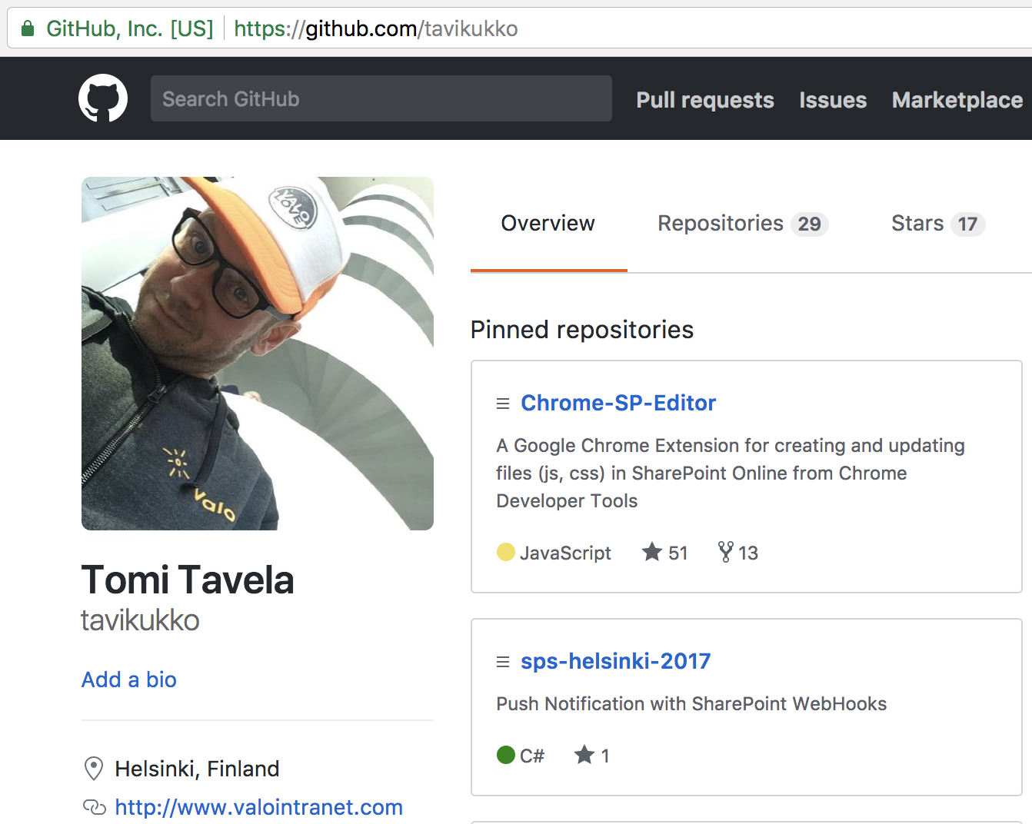
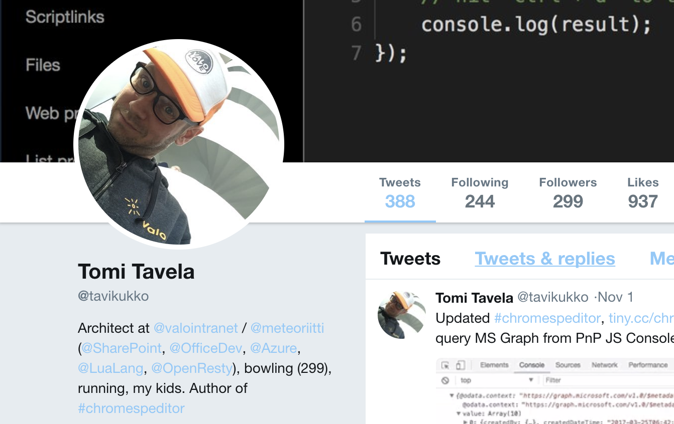
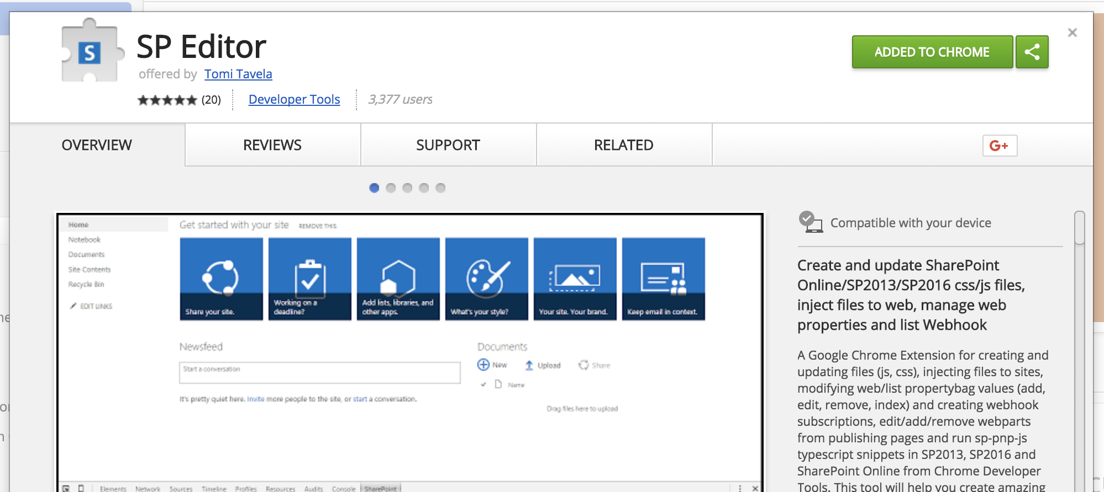
Tomi Tavela
Software Architect
Valo Intranet, BM
SP Editor

Slide 4
Agenda
SharePoint + Mobile
SharePoint WebHooks
Azure Functions
Azure Notification Hub
iOS Application
3 steps:
Subscribe devices to receive push notifications
Subscribe Azure Functions to receive notifications from SharePoint
Send notification from SharePoint to devices
Demo times!!
Mobile development with Ionic, some samples ?
SP Editor demo ?

Slide 5
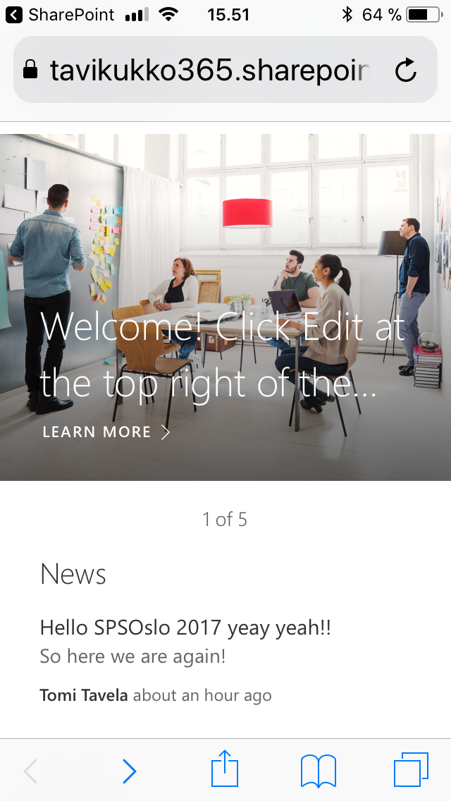
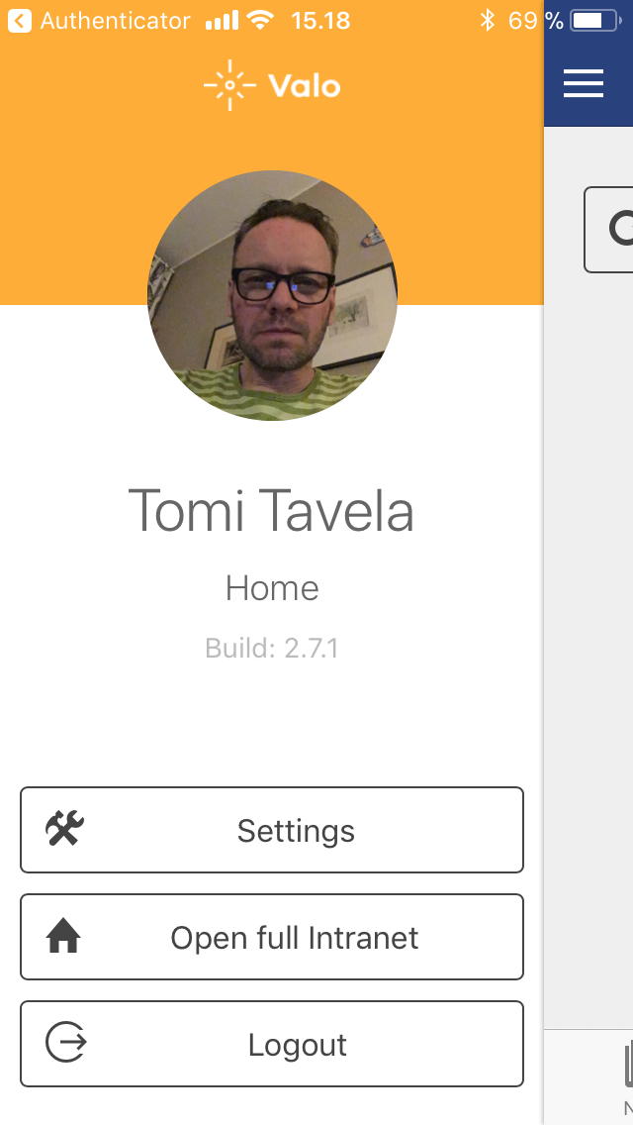
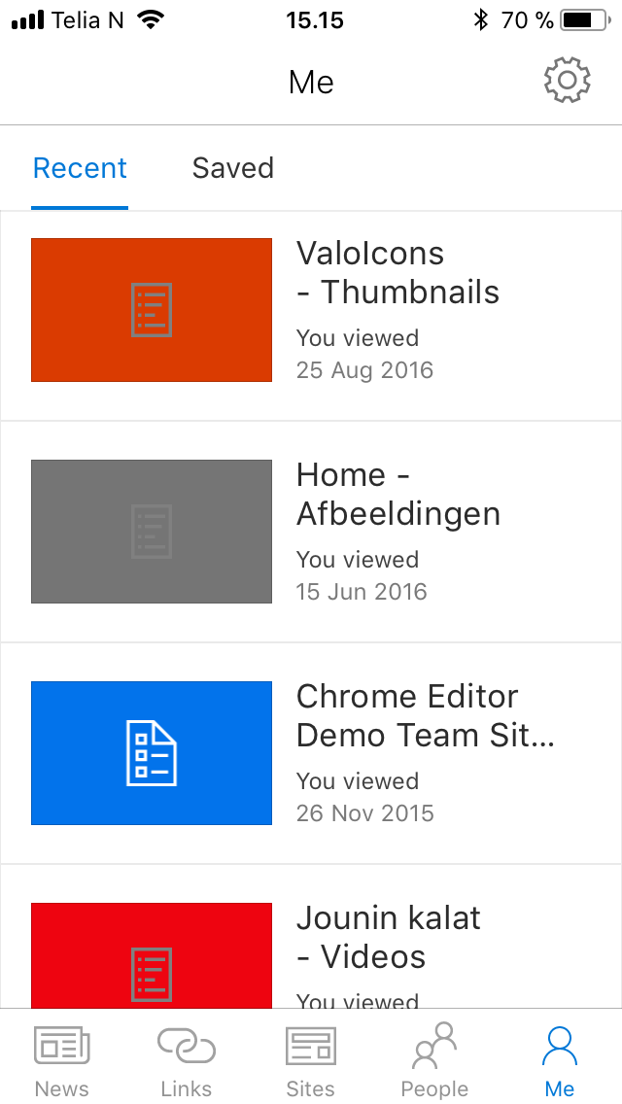
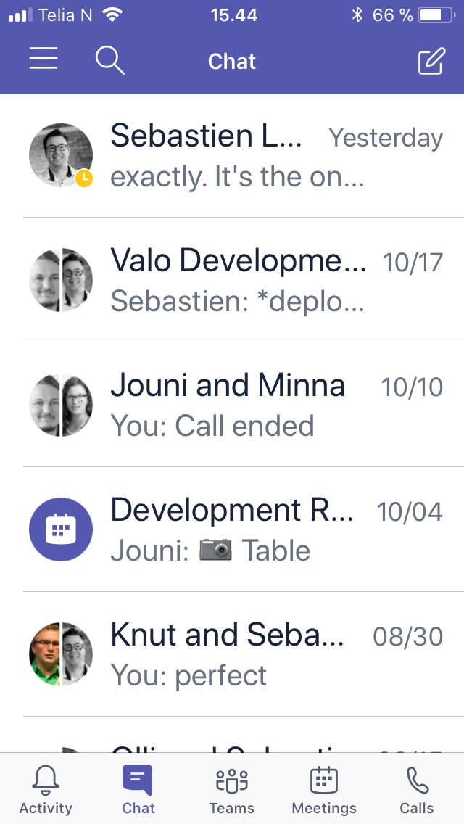
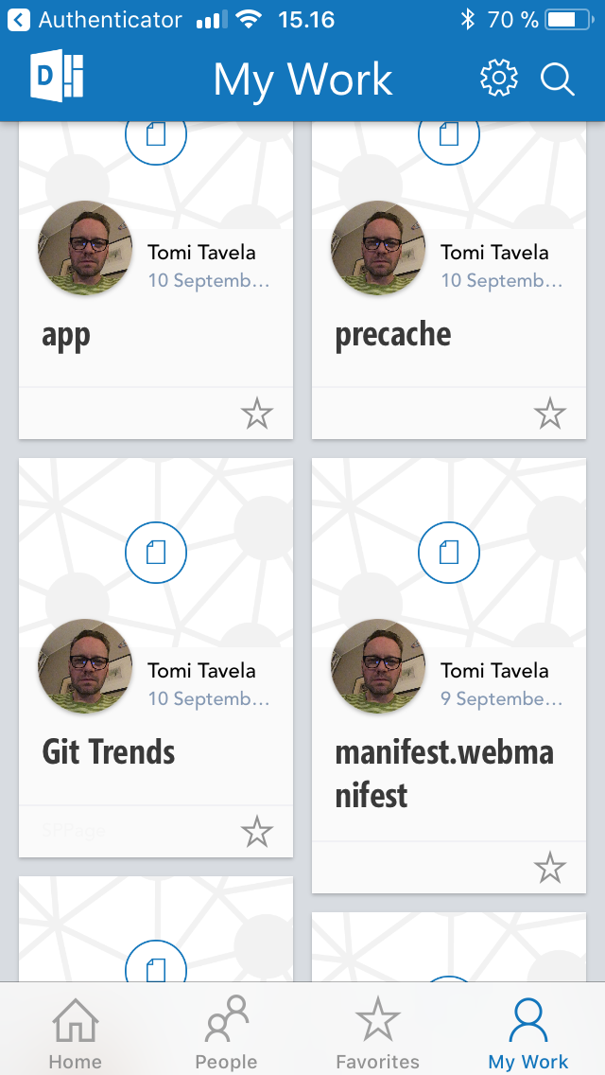
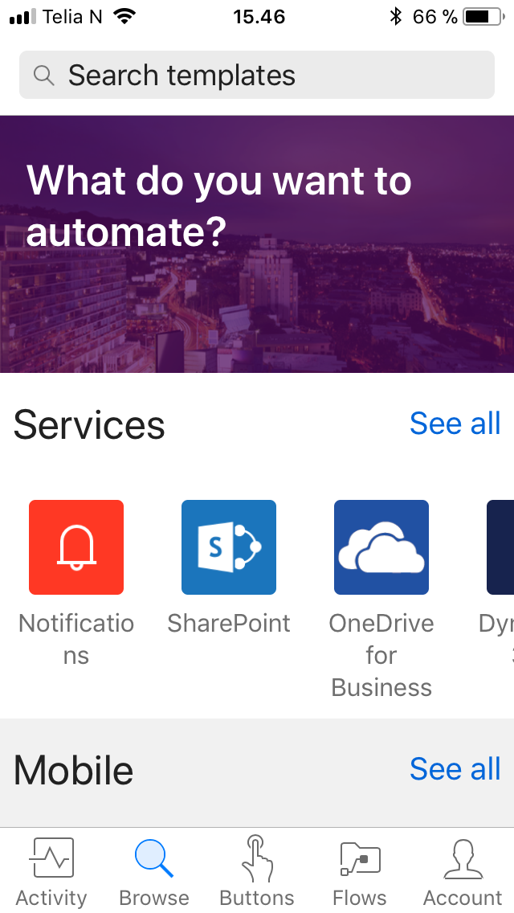
SharePoint and Mobile
Browser
Valo Intranet
SharePoint
Teams
Delve
Flow

Slide 6
SharePoint WebHooks
Available in SharePoint Online
Gets triggered when something happens in a list
Will send a POST request to the subscribing endpoint
Request contains information of the resource changed (json)
What about other options?
Workflow
Remote Event Receiver
Microsoft Flow
Azure Logic Apps
https://dev.office.com/sharepoint/docs/apis/webhooks/overview-sharepoint-webhooks

Slide 7
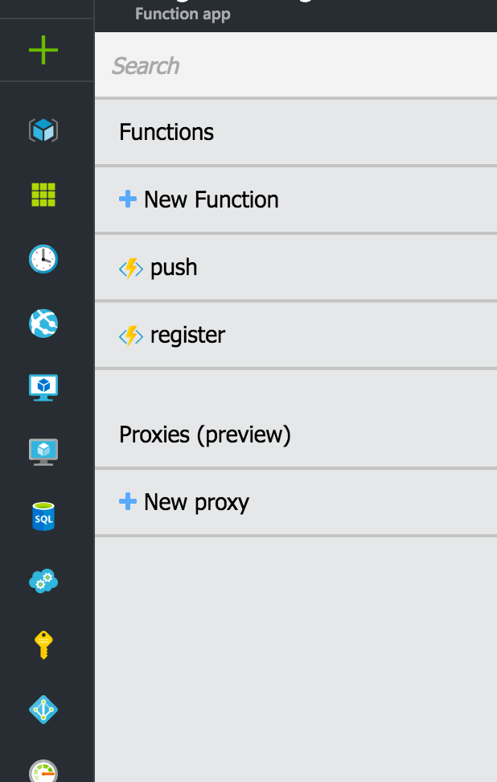

Azure Functions
Serverless applications in Azure
Call API -> execute code
In the Demo:
endpoints
/register
For registering devices with Notification Hub
/push
For sending notifications to Notification Hub
https://azure.microsoft.com/en-us/services/functions/

Slide 8
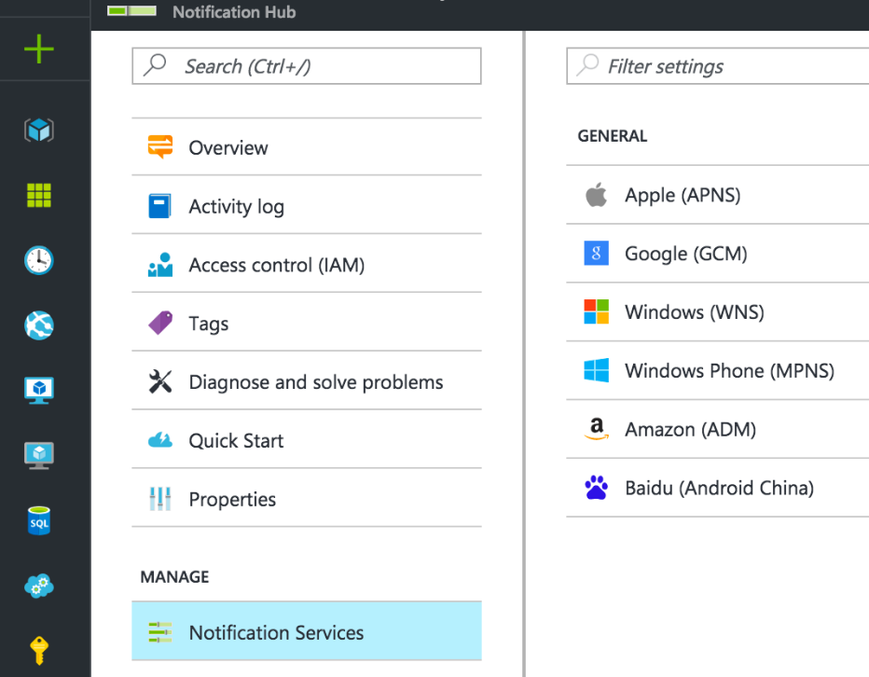

Azure Notification Hub
Manages all devices that are registered
Id
Tags
Manages Platform Notification Systems
Apple Push Notification Service, APNS
Firebase Cloud Messaging (google), FCM
Windows Notification Service, WNS
https://azure.microsoft.com/en-us/services/notification-hubs/

Slide 9

iOS Application
Created with Ionic Framework https://ionicframework.com
If you go mobile → macOs
Builds for iOS & android
Modern SharePoint dev, windows in Azure VM
Hybrid apps, Typescript + CSS + HTML + Cordova
Native-script, React-native → faster apps, not so fast to develop
Multiple platforms, single codebase
What does it do?
Gets specific device id from Platform Notification Service
Sends that device id to Azure Functions
Azure Functions will add it to Notification Hub
Receives push notifications

Slide 10
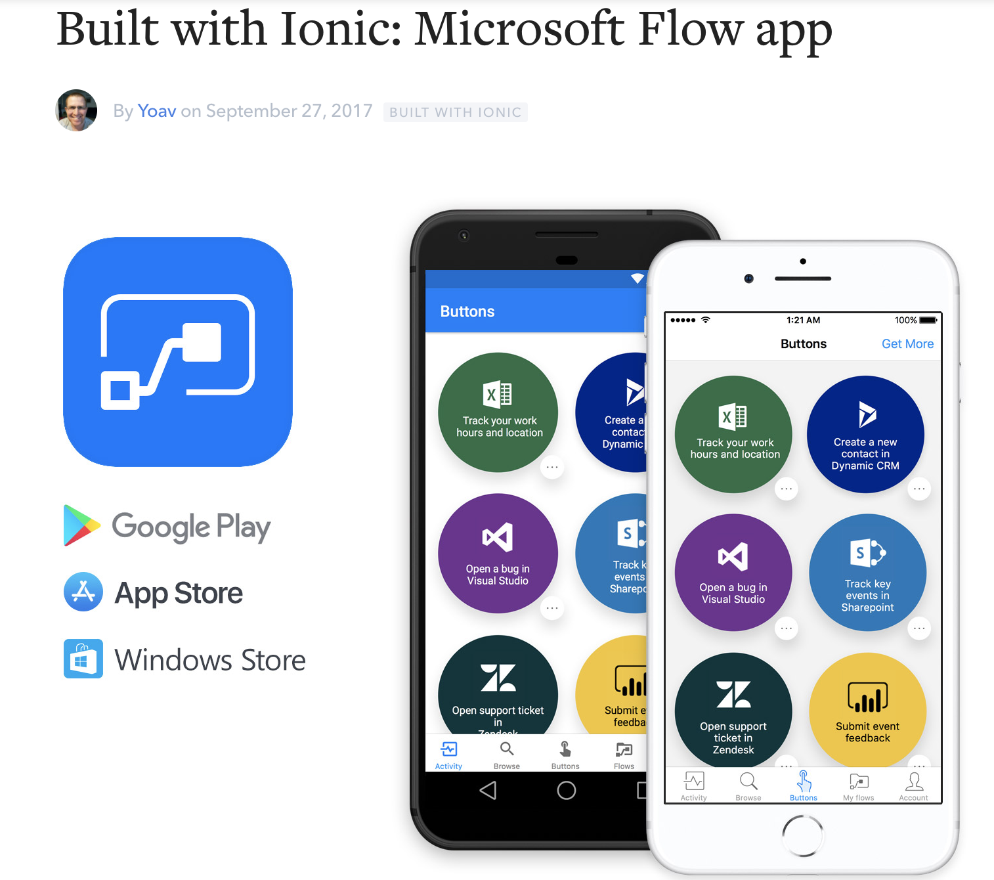

Slide 11

Step 1: Subscribe for notifications from SharePoint
validationtoken
/push
validationtoken

Slide 12
Demo times!

Slide 13
Step 2: Subscribe devices to receive push notifications
device id
/register
APNs
device id
device id

Slide 14
Demo times!

Slide 15
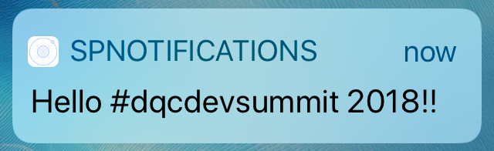
Step 3: Send notification from SharePoint to devices
APNs

Slide 16
Demo times!

Slide 17
Mobile development with Ionic, some samples

Slide 18
SP Editor demo

Slide 19
Thank You Questions?
DQC Dev Summit 2018
Tomi Tavela
Valo Intranet / Sininen Meteoriitti

